Slide 1
Reinlife: a Platform for ML Based Mobile Mental Health Study
Fadwa AlAskar, Boer Zhang, Wenyun Wang, Walt Williams, Zana Bucinca, Weiwei Pan, Finale Doshi-Velez

Slide 2
Outline
Project Overview
Platform Architecture
Platform Design and Implementation
Conclusion
Future Work

Slide 3
Project Overview
Problem: There is significant in lack the the current state-of-the-art mHealth platforms’ capability to help users build skills that are applicable across various aspects of mHealth personal development. In addition , the researchers need to deeply understand their patients and track their mental health situation. This issue is significant due to the growing popularity of mHealth apps and the need for more effective and holistic interventions.
Key gaps:
Lack of Personalization.
Limited Reinforcement Learning (RL) Application.
Insufficient Researcher Tools.
Absence of Open-Source RL Platforms.
Narrow Mental Health Focus.
User Engagement Strategies.

Slide 4
Project Overview
"ReinLife" addresses the challenge of limited cross-cutting skill development in mHealth apps by providing an open-source platform for personalized mental health interventions.
Key features:
Personalized Interventions: Uses reinforcement learning algorithms for tailored mental health interventions.
Dynamic Experiment Configuration: Allows researchers to customize study parameters easily.
User Feedback Collection: Integrates surveys for user responses to interventions.
Ease of Use for Researchers: Designed for ML and clinical researchers, focusing on experimentation and analysis.

Slide 5
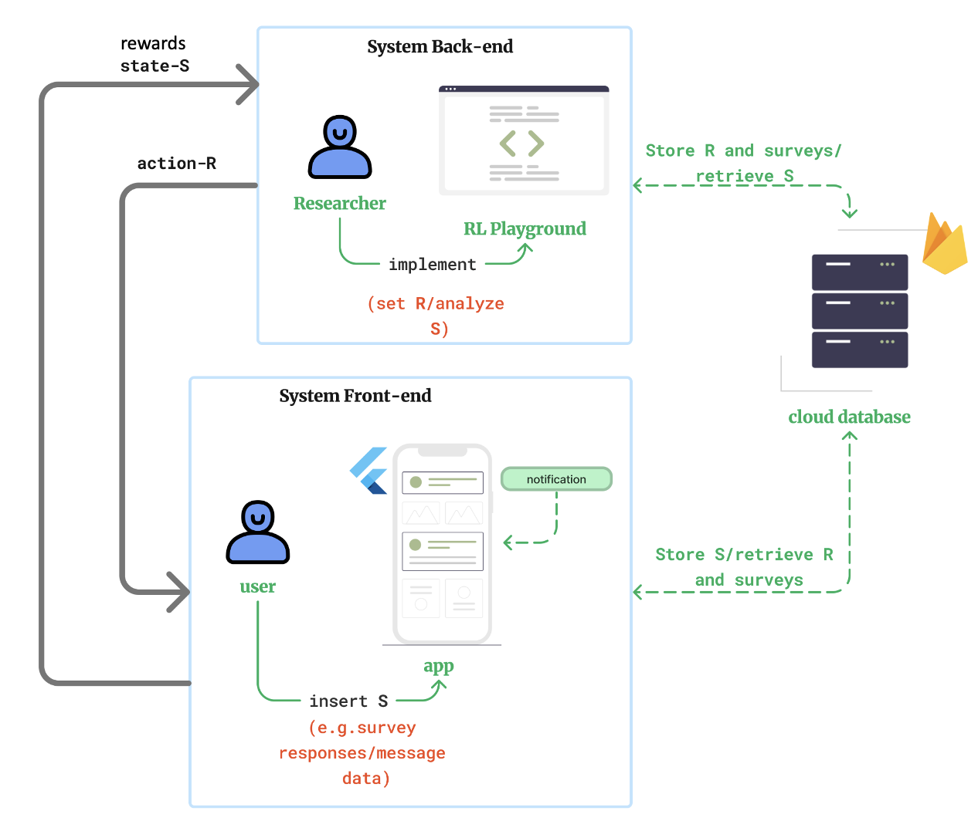
Platform Architecture
The platform architecture integrates a front-end mobile application for user interaction and data input, and a back-end for researchers to manage and analyze data. The cloud database centralizes the exchange, storing user responses and researcher-defined parameters for interventions, leveraging a reinforcement learning framework to personalize mental health support.

Slide 6


Frontend Design
The frontend is a mobile application that provides an interactive environment that enables the users to communicate with and respond to researchers’ studies and interventions.
The application is implemented using Flutter platform for multiplatform mobile apps and Firebase platform for storing and managing data and notifications as well.
It contains there main pages:
User main page: this is the first page that appears to the user when they open the app.
User registration button: allows users to register their device token to the backend
Notifications history button:
Navigates users to the history page where all past notifications are listed
Message: contains chat messages between the user and the researchers .
Questionnaire: contains questionnaires provided by the researchers for the user.
Firebase AdminSDK
&
Firebase Cloud Messaging functions

Slide 7
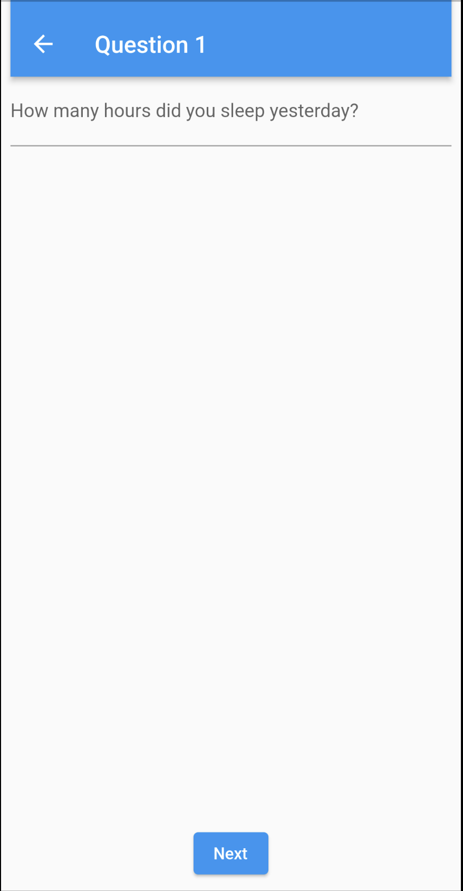
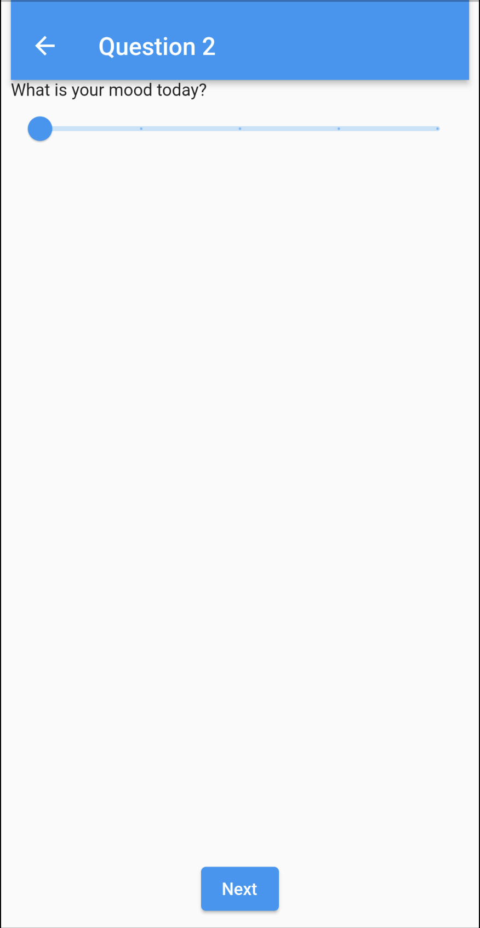
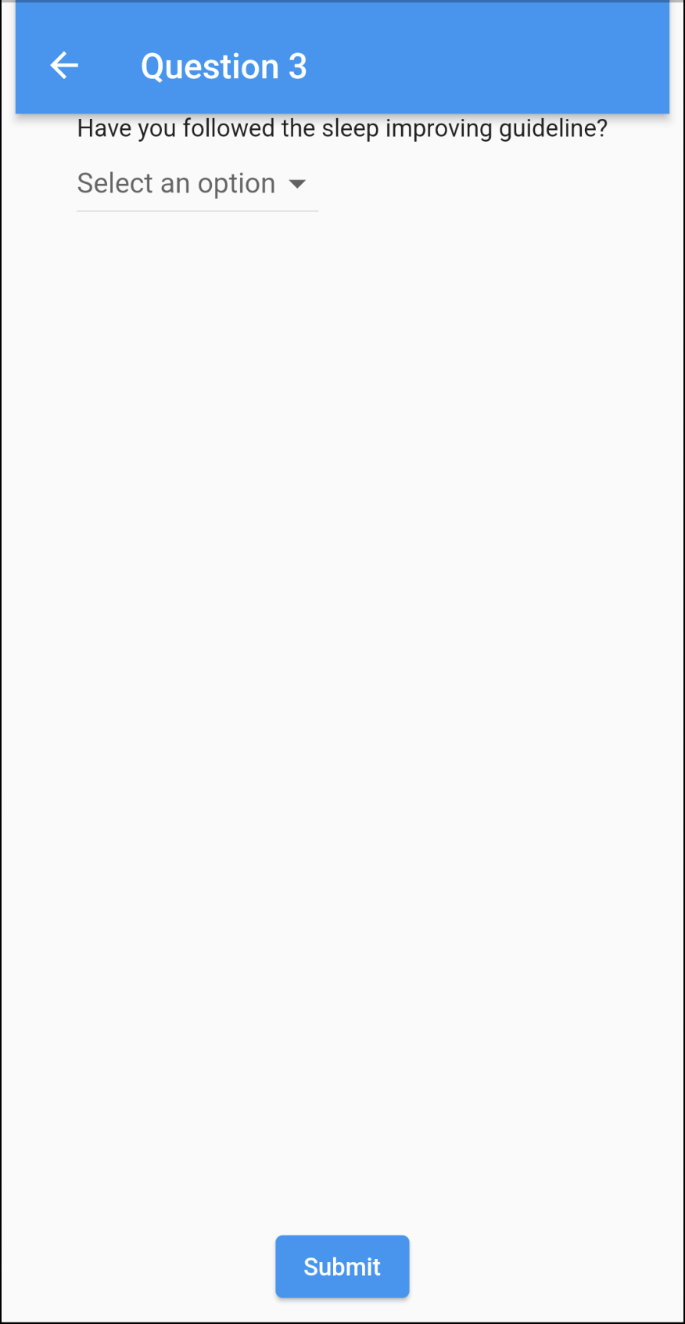
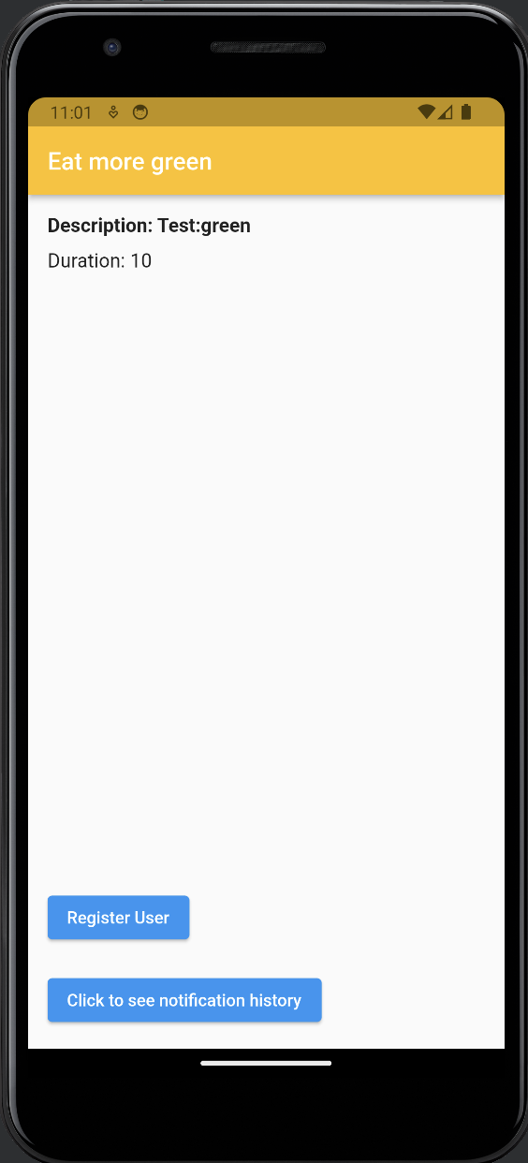
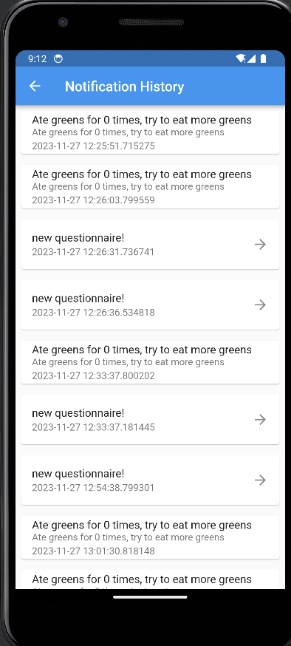
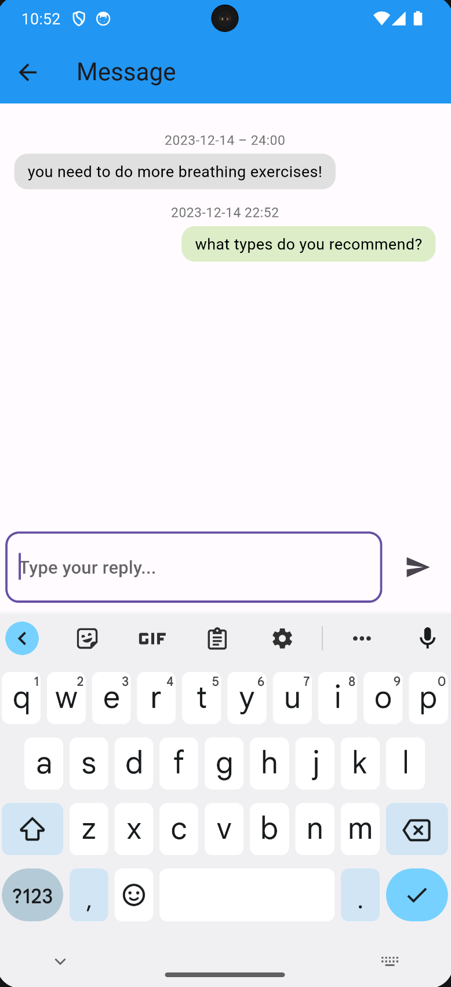
Frontend Design
Questionnaire is clicked
Questionnaire
Message is clicked
Main page
Notification history
Message

Slide 8
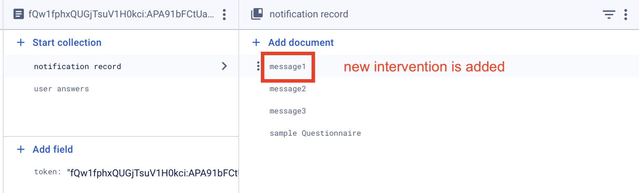
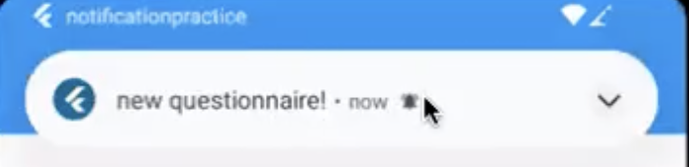
Cloud Database

Slide 9
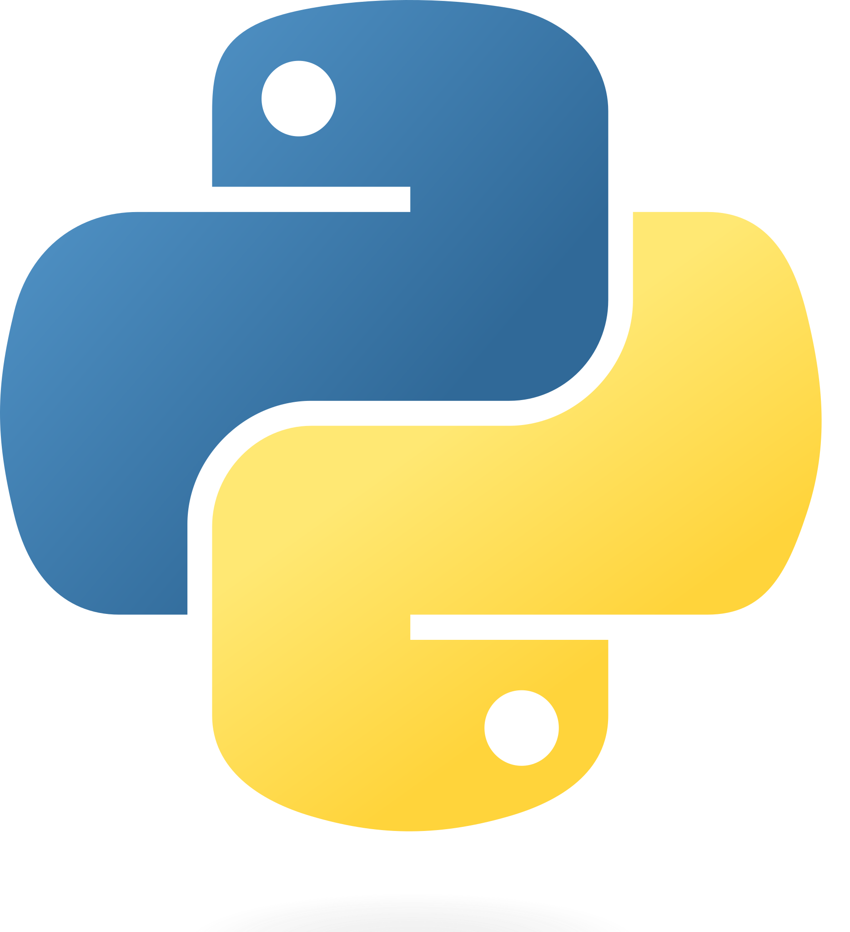
Backend Design
Google Firebase:
Cloud Messaging Notification for notification
Firestore database
Python APIs for researchers to:
Set up experiment information and questionnaires
Send interventions based on users’ answer to questions
Firebase AdminSDK

Slide 10
Conclusion
"ReinLife" represents a significant advancement in mobile health (mHealth) technology. Its innovative use of machine learning and open-source design positions it as a versatile tool in mental health research. By enabling dynamic experiment adjustments and ML-based interventions, it offers a new level of customization and effectiveness in studying mental health. This platform not only enhances current research methodologies but also paves the way for more nuanced and impactful studies in the field of mental health.

Slide 11
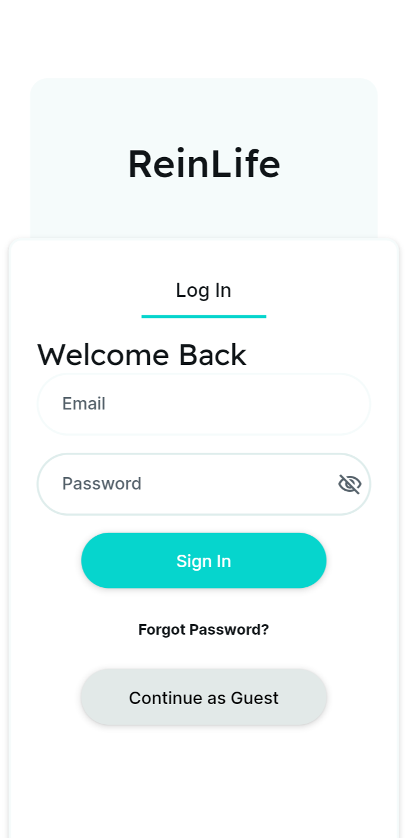
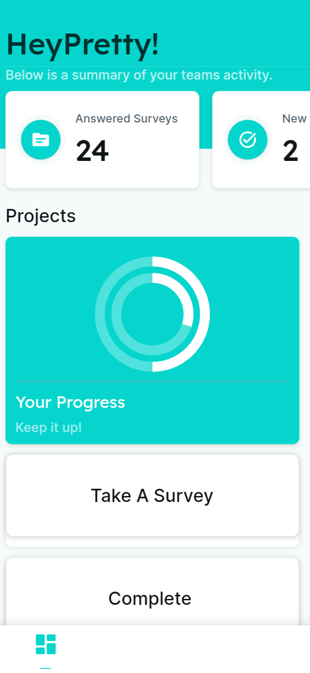
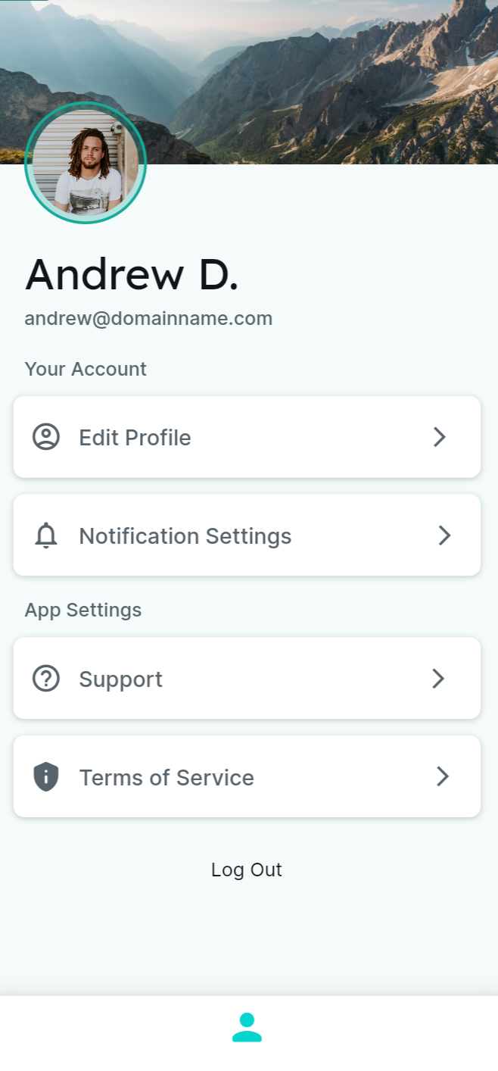
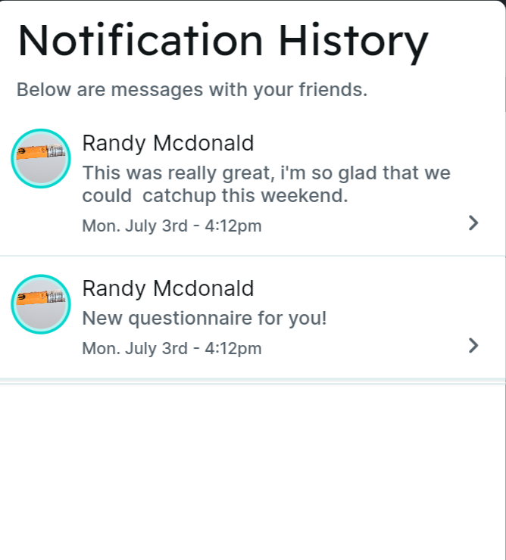
Future Work
Better user interface design.
Collaborate with partner (Harvard Dtak Lab) to test the platform.
Design command line scripts/containerized environment to allow researchers to easily configure and use our platform.
Our intended refined UI design!

